Slide 1






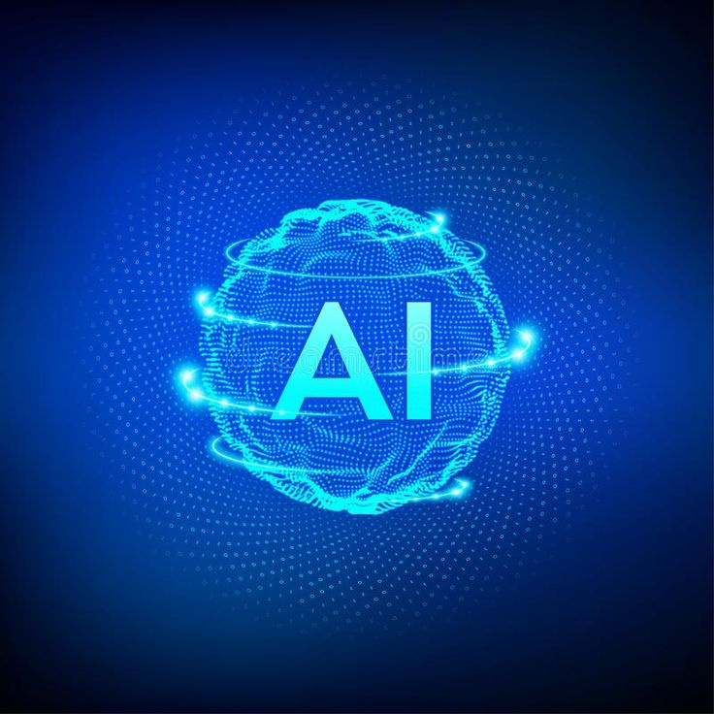



CDUT 2025 International Summer School
Summer Camp on AI-driven Sustainable Urban Development
July 7 - July 28, 2025
Dr Grace U. Nneji
Dr Happy N. Monday

Slide 2

By the end of this chapter, you will understand the importance of environment setup in AI workflows and how to avoid common pitfalls.
Learning Objectives
You will learn to install and manage essential AI libraries, ensuring that your projects run smoothly without compatibility issues.
Mastering Environment Setup for AI
You will be able to set up and test a reproducible development environment, which is crucial for collaboration and experimentation in machine learning projects.

Slide 3





Why Environment Setup Matters in AI
A solid environment setup ensures reproducibility by allowing you to share results and re-run experiments with identical dependencies. This is essential in AI projects where consistent outcomes are necessary for validation.
Understanding environment setups, such as virtual environments and Python distributions, can help prevent issues during development. With the right setup, learners will be prepared to tackle complex AI tasks efficiently.

Slide 4


Recommended Hardware Setup
Minimum Requirements for AI
Step 01
Step 02
Step 03
For optimal performance, 8 GB RAM is required, but 16 GB or more is preferred to handle intensive AI workloads efficiently.
A multi-core Intel/AMD CPU is essential for running multiple processes simultaneously, enhancing the overall performance of AI applications.
An NVIDIA CUDA-enabled GPU is recommended for deep learning tasks, as it significantly accelerates model training, especially with libraries like TensorFlow or PyTorch.

Slide 5



Environment Setup Essentials
Why Environment Matters
Installing Python
Using Anaconda
Python installation is straightforward; visit the official site and follow the setup instructions to configure your environment properly for AI development.
Anaconda offers a user-friendly interface and package management, making it easier to handle complex AI libraries and maintain isolated environments.
A solid development environment ensures reproducibility and efficiency in AI projects, minimizing potential errors across your workflows.

Slide 6





Virtual Environments
Understanding Their Importance
Virtual environments are essential for managing dependencies in AI projects. They allow developers to create isolated environments, ensuring that package versions do not conflict across different projects. This isolation is crucial for reproducibility, as it enables teams to share results and rerun experiments with identical setups. Furthermore, virtual environments facilitate collaboration, making it easier for multiple users to work on the same project without encountering versioning issues.

Slide 7
Python is a widely used high-level programming language known for its simplicity and vast ecosystem of scientific libraries. Most AI frameworks are Python-based.
Step-by-step:
1. Go to python.org/downloads (https://www.python.org/downloads/)
2. Choose Python 3.11.x for Windows
3. During setup, enable:
✅ "Add Python to PATH" (adds Python to system environment variables)
✅ "Install launcher for all users"
Python Installation
(Windows)
Confirm Installation:
python --version
pip --version
Expected output:
Python 3.11.x, pip 23.x.x

Slide 8
Anaconda is a free, open-source distribution of Python and R specifically designed for data science and AI. It includes:
· conda (environment and package manager)
· Pre-installed libraries like NumPy, Pandas, Matplotlib
· JupyterLab (web-based notebook environment)
Step-by-step:
1. Visit anaconda.com (https://www.anaconda.com/products/distribution)
2. Download the latest version
3. Install and open Anaconda Navigator (GUI) or use the command line
Anaconda Installation
(Alternative to pip)
Conda Environment Example:
conda create --name ai_env python=3.11
conda activate ai_env
Use Anaconda when managing complex environments with large ML/DL libraries and GPU support.

Slide 9
Virtual Environments (Why & How)
A virtual environment is an isolated Python environment where you can install packages without affecting other projects or the system Python.
Using venv (pip-based):
python -m venv ai_project
# Activate:
ai_project\Scripts\activate # Windows
source ai_project/bin/activate # macOS/Linux
pip install numpy pandas
Using conda:
conda create --name ai_project python=3.11
conda activate ai_project

Slide 10
Essential Python Libraries for AI
These libraries form the backbone of AI workflows, each handling a distinct part of development pipeline
Numpy - for numerical computing
Pandas - for data manipulation and analysis
Matplotlib - for plotting graphs for data visualization and exploratory analysis
Seaborn - simplifies statistical visualizations
Scikit-learn - ML toolkit for classification, regression and clustering tasks
Tensorflow - to build and deployments AI models
JupyterLab - IDE for live code, visualization and documentation
Streamlit - commonly used for building AI dashboards
Supabase - open source Firebase alternative

Slide 11


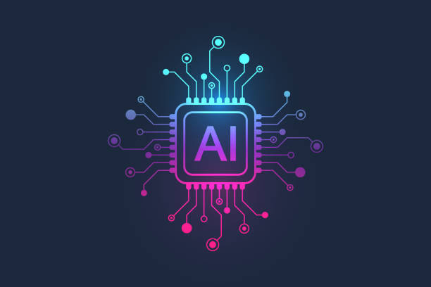


Documentation Links for Key Libraries
NumPy: https://numpy.org/doc/
Pandas: https://pandas.pydata.org/docs/
Matplotlib: https://matplotlib.org/stable/contents.html
Seaborn: https://seaborn.pydata.org/
Scikit-learn: https://scikit-learn.org/stable/user_guide.html
TensorFlow: https://www.tensorflow.org/api_docs
PyTorch: https://pytorch.org/docs/
Streamlit: https://docs.streamlit.io/
Supabase: https://supabase.com/docs

Slide 12

Day 1 Summary
Environment setup is the backbone of any AI workflow
Use virtual environments (venv, conda) to isolate and manage dependencies
Install libraries based on project needs (ML, DL, data processing)
Always document environments for collaboration and deployment

Slide 13
Take-Home Questions
1. What’s the difference between ‘pip’ and ‘conda’?
2. Why is it risky to install all packages in the system Python?
3. What are three AI libraries you would install for tabular modeling?
4. How does environment export help in collaboration?
5. Compare ‘venv’ and ‘Anaconda’ as environment solutions.

Slide 14
Thank you for your active participation and thoughtful engagement throughout this lecture.

